Slide 1
<PROJECT NAME>
Kick-off Meeting
Date: YYYY.MM.DD

Slide 2
Content
↘
1
Project Summary
7
Working Model & Process
13
Standard process
2
Project Organization
8
Performance Metric Measurement
14
<Additional>
3
Role And Responsibility
9
Constraint and Assumptions
15
<Additional>
4
Master Schedule
10
Risk Management
5
Deliverables
11
Security Assurance
6
Communication & Reporting
12
Working space

Slide 3
Project Summary
Project Vision/Mission
  UX/UI reorganization and mobile sales advancement.
Project Scope
  Development scope will be included
    Setting up the local Development Environment
    Performing the Basic Design, Detail Design, Coding, Unit Test, Integration Test.
    Deploying the source code packages
    Supporting UAT/System test
Project Period
  Design: yyyy/MM/dd ~ yyyy/MM/dd
  Coding: yyyy/MM/dd ~ yyyy/MM/dd
  UT&IT: yyyy/MM/dd ~ yyyy/MM/dd
  Support UAT: yyyy/MM/dd ~ yyyy/MM/dd

Slide 4


2. Project Organization
LG CNS
FPT KOREA
FPT DA NANG
Senior Manager
ABC
Delivery Manager
ABC
Operation Manager
ABC
Project Team
Project Manager
ABC
Technical Leader
ABC
Project Leaders
ABC
FPT-Onsite PM
ABC
Developer/Tester
X members
Korean
BA/Communicator
ABC
QC
ABC

Slide 5
3. Role And Responsibility
Name | Role | Responsibility
ABC | Operation Manager/ Senior Manager | ODC (Offshore Delivery Center) main contact point Predict ODC resources needed to reach objectives, prepare ODC budgets, scope of work, and play a hands-on, lead role in managing budget and other resources in an effective and efficient manner Play a lead role in determining and monitoring performance metrics for the ODC's projects initiatives to measure progress and identify areas for improvement Develop and deliver comprehensive analysis and final reports for stakeholders, including evaluations of ODC feasibility and achieved met
ABC | Delivery Manager (DM) | Preparing master plan and profit & lost for all projects Work with customer’s project manager to collect needs of projects from departments Responsible for coordinating with customer’s project manager in solving project problems/ issues Review and responsible for assessment report/ estimation/ proposal
ABC | Project Manager(PM)/ Team leader | Offshore project development team main contact point Manage and responsible for project's progress, quality, scope, cost Task assignment and monitoring of team members Organize meeting/ workshop, detect and resolve issues Review and responsible for assessment report/ estimation/ proposal
ABC | Business analyst (BA) | Work with customer’s project manager or onsiter to get requirements, make system specification documents and transfer to development team Study requirement based on customer’s request Communicate and transfer to the development team to ensure understanding exactly customer requirement Support team and manage the Q&A Confirmation about the function requirement with Business user or Product owner Verify and responsible for output of development base on business requirement

Slide 6
3. Role And Responsibility (Cont.)
Name | Role | Responsibility
ABC | Developer (Dev) | Performing the work of the assessment phase Coding, unit testing and give the commitment for quality and task completion
ABC | Tester/QA | Performing the work of IT (Integration Test) and ST (System Test) including Test View-Point, Test Scenarios, Test Plan, Test Case, Test Result Commitment for quality and task completion
ABC | Quality Control | Follow and control project process

Slide 7
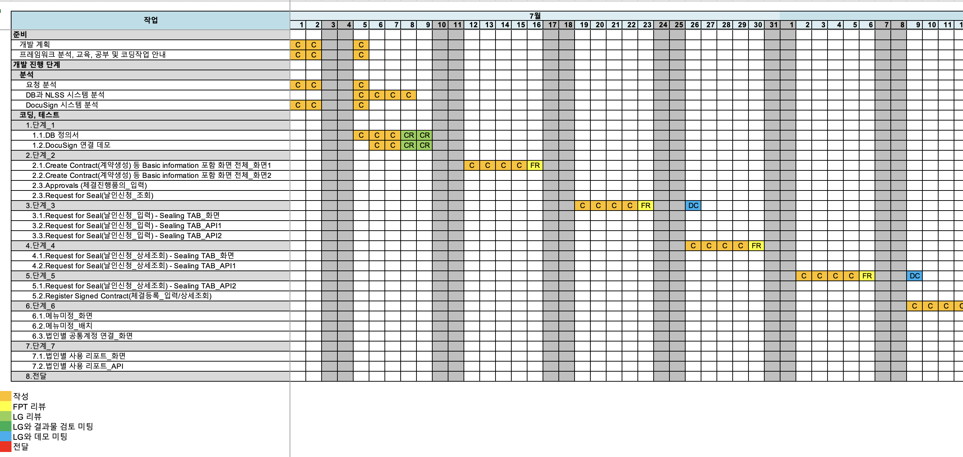
4. Master Schedule

Slide 8
5. Deliverables
Agile Methodology
FPT will deliver the following items to LG CNS in a timely fashion, which will be subject to review and approval by LG CNS. Any additional items not included in the provided list may have an impact on the project's cost and schedule and will be managed as part of the change management process.
 | Items | Frequency
1 | Database Design document (DDD) | Every Sprint Release (if there any changes)
2 | SRS & Mockup documents | Every Sprint Release
3 | Release Notes | Every Sprint Release
4 | Test Report | Every Sprint Release
5 | Source Code | Every Sprint Release
6 | Installation Guide | Final Release
LG CNS and FPT will apply the following criteria to determine whether deliverables are accepted or not
Sprint Acceptance Criteria
100% of User Stories/Use Cases have been completed, including coding, testing, bug/defect fixing, and committed source code, as committed in the Sprint backlog. | User stories must be approved by the Product Owner prior to the sprint grooming. | There are no showstopper or blocker defects. | The Product Owner is responsible for providing sign-off for each sprint.
Project Acceptance Criteria
All requirements and deliverables have been formally verified and approved. • 100% of User Stories/Use Cases have been completed, including coding, testing, bug/defect fixing, and committed source code. | There are no showstopper or blocker defects. | User Acceptance Testing (UAT) has been completed and signed off by the designated team from LG CNS | The UAT test cases provided by the client will serve as the basis for acceptance.

Slide 9
5. Deliverables (Cont.)
Waterfall Methodology
Period | Deliverable | Acceptance Criteria
Preparation | Assessment about input of LG CNS | FPT: All requirement of LG CNS must be fully understanded
Detailed Design | Detailed design | LG CNS will check, review and approve all deliverables follow the schedule agreed by FPT and LG CNS
Coding + Unit Testing | Source code UTC/UTR | FPT: The code has fully covered and correctly complied with requirement and coding convention FPT: Follow the coding convention & checklist. FPT: Reflects all requirements (including Q&A) in source code. LG CNS: All comments must be fully reflected / fixed.
Support UAT | Source Code UTC/UTR | LG CNS: All defects must be fixed & deployed fully without any problems

Slide 10







6. Communication & Reporting
Communication Model
Communication Channels
FPT
LG CNS
(1) Official channels: Issue Tracker, Email, Conference Call, Wiki
+ Issue Tracker: for managing all tasks, bugs
+ Email: for official requests
+ Conference Call: for weekly meeting, demo
+ Wiki: for knowledge base, knowledge sharing
(2) Quick channels: Workplace, Group Chatting, Face2Face
+ Workplace: for general sharing, notification to all teams
+ Group Chatting: for quick discussion with all teams
+ Face2Face: for quick discussion (@Korea side)
PM
PM
TL
Team Leader
…
…
Developer
HelpDesk for LG CNS PM
Link: https://forms.office.com/r/sFnJ31FKk1
Communication Tools
Issue Tracker
Wiki
Email
Workplace
Conference Call
Group Chatting
Face 2 Face

Slide 11
6. Communication & Reporting
Communication to LG CNS
Communication Type | Route | Information | Method/ Tool | When
Kick-off Meeting | PM ➝ LG CNS | ・ Introduce about the project ・ Review project plan ・ Review risk / issue project. | Meeting | TBD
Weekly Meeting | FPT, LG CNS | ・ Review progress ・ Review issue is facing | Teams | Weekly Thursday
Q&A | PM, PTL ➝ LG CNS | ・ Add Q&A | Wire Wiki/Excel | Anytime
Chat/Video Conference | FPT ➝ LG CNS | ・ Quick communication in inform form (Q&A / bug LG CNS priority confirm, issues urgent (not including analysis), ...) | Teams | Anytime
Deliver Product | PM ➝ LG CNS | ・ Release / release note products are uploaded to the agreed folder. ・ Email delivery after successful upload. | Mail | End of stage
Escalate | PMO/BOD ➝ LG CNS | Escalate serious issues affecting the project (security, quality, progress ...) | Mail | Anytime
Project Task tracking
Communication Type | Route | Information | Method/ Tool | When
Daily Task Report | DEV ➝PTL/ PM | ・ Report task progress everyday ・ Report issue encountered. | Excel | Daily 4:30 PM
 | DEV ➝ TL | ・ Add Q&A ・ Report issue | Wire wiki, Report | Anytime
Task Assign | PM/PTL ➝ DEV | ・ Assign daily task | WBS
Daily Meeting | Team ➝ PM | ・ Report task progress everyday ・ Report issue encountered. | Standing | Daily 8:30
Chat | FAW | ・ Push / Remind | FAW | Anytime

Slide 12
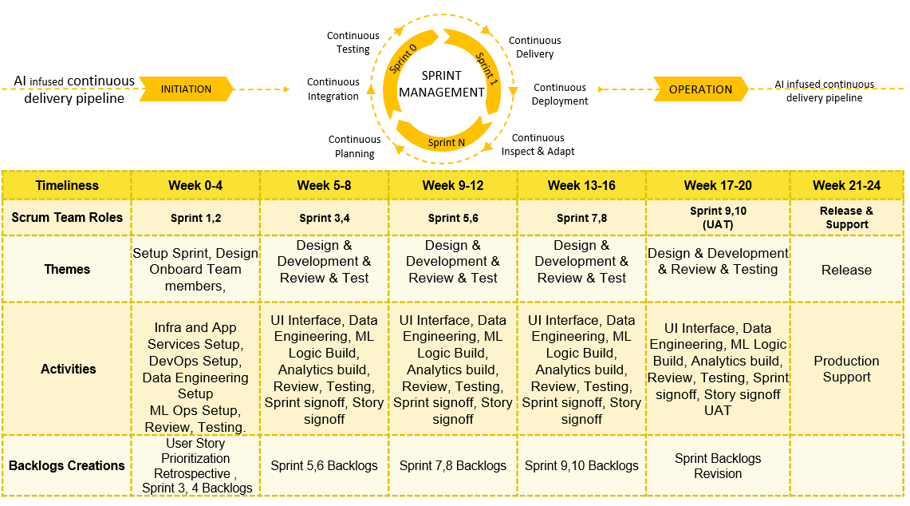
7. Working Model & Process
Agile Methodology
(a) Development Model
Insert image that is relevant to Project below. Sample given below.

Slide 13
7. Working Model & Process
Waterfall Methodology
(a) Development Model
REQUIREMENT ANALYSIS
The BA group performed an analysis of the requirements assigned to LG CNS and produced the High-Level Design
WATERFALL
1
IMPLEMENTATION
DESIGN
Development Team has implemented Coding according to Design that has been reviewed & approved
The Development Team is based on the results of analysis and implementation of the Detail Design
2
3
VERIFICATION
4
Create test case and verify source code (Black-Box & White Box)
MAINTENANCE
Once completed all will move on to the maintenance Iteration

Slide 14
7. Working Model & Process
(b) Development Process
Transfer
- All team
- Review
- Feedback
Define Solution
- Collects
- Discuss
- Finally
Coding
- Coding convention
Unit Test
- Check list
- Basic cases
Review
- Self Review
- Group Review
Deliver to LG CNS

Slide 15
7. Working Model & Process
(c) Change Request Process
  The Requirement Specification must be approved before coding.
  If any updates are requested after approving, FPT must determine if they are Change Requests or Defect
Defect
(Bug)
Defects are issues that do not match the requirements
Defects are covered under the warranty and will be fixed based on the priority of the issue
Change Request (Enhancement)
Change Requests are updates to the requirements
FPT will estimate the effort involved to implement the request and obtain approval for the additional cost

Slide 16
7. Working Model & Process
(d) Quality Assurance
1. Prepare Project
2. Assessment
3. Coding
4. Unit Testing
5. Deployment
6. Support bug fixing
Review
Strategy
Group review
(※1)
Self review
TL review
LG CNS review
Comments/bugs
Implement simultaneously for similar displays / functions
(※1) Select the Group review function / screen according to the following conditions:
- Functions / screens are complex
- Function / screen performed for the first time
- Function / first screen of new member

Slide 17
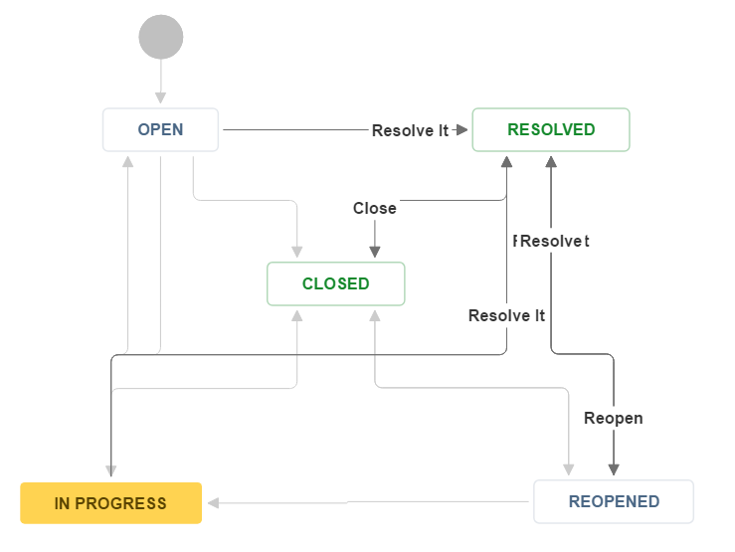
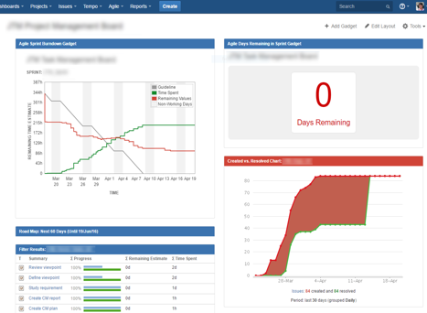
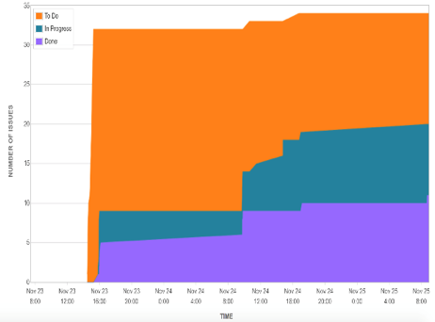
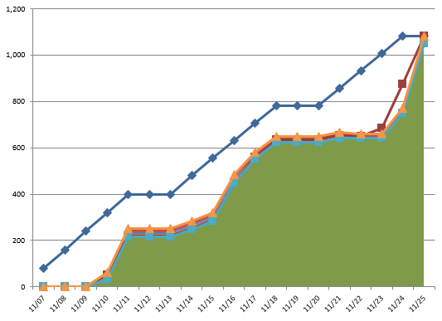
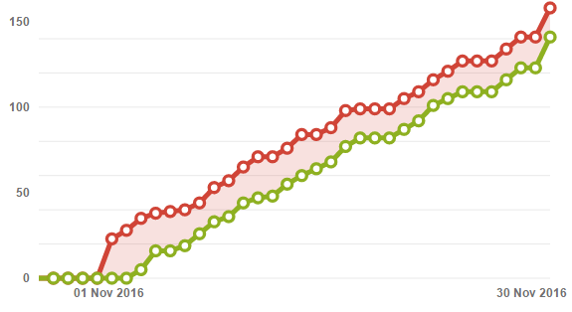
7. Working Model & Process
(e) Task and Issue Management System
Workflow of Wire wiki Tasks
Project Dashboard
Task Processing Chart
Testcase Execution
Bug Resolving Chart
(f) Issues Escalation Path
Level 1 Escalation (In Team)
Manager/Customer
Email/Phone/Chat
Level 2 Escalation (In Project)
Onsite PM (FPT Korea)
Email/Phone/Chat
Level 3 Escalation (Out of Project)
Delivery Head (FPT Korea)
Email/Phone/Chat
Highest Level Escalation (Company Level)
FPT Software BOD
Email/Phone/Chat

Slide 18

8. Performance Metric Measurement
Category | Metric | Formula | Norm
 |  |  | Red | Neutral | Green
Performance | Development productivity based on LG CNS standard | LG CNS Standard Productivity/ FPT Actual Productivity (MD/Function) | > 70% | 75% | < 80%
The norm is referenced from similar projects with the same Technology, Development Scope and Business Domain.
Productivity is calculated monthly based on the template agreed upon with LG CNS.

Slide 19
9. Constraint And Assumptions
Dependency, Constraint
The following dependency/constraint can be changed depending the information of response or answer from LG CNS
# | Description | Type | PIC
1 | LG CNS has to provide environment construction procedure manual for the target development/testing system. It also include software related to the target development system, third parties (including licenses if necessary) | Environment | LG CNS
2 | For high priority questions, LG CNS feedback time is within 1 day For medium / low priority questions, LG CNS feedback time is within 2 days In case of urgent need or need further investigation, the deadline feedback will be discussed | Communication | LG CNS
3 | All change request (if any) must be approved before development starting. | Scope | FPT/LG CNS
Assumptions
# | Description
1 | LG CNS provide development environment for FPT
2 | Non-functional requirements (performance, security) are out of scope of FPT
3 | The Integration phase will be implemented by LG CNS, FPT only support fix bugs for LG CNS
4 | Architecture Design/Design/Testcases are out of scope of FPT
5 | FPT will confirm with LG CNS for library/plugin/widget/3rd free license that use for development. LG CNS will provide & paid cost for library/plugin/widget/3rd (if any)

Slide 20
10. Risk Management
Risks identified as of today are listed below:
# | Category | Risk | Probability | Impact | Mitigation/ Contingency | Owner
1 | Required Skillset of Human resource | The project is assigning the senior developer, but since they are approaching the system for the first time, productivity may not be high, and the product quality may suffer. | High | Productivity, Quality | Mitigation Action: - Pair the senior developer with a more experienced LG CNS team member who is familiar with the system to mentor and guide them through the initial phases of development. - Implement regular code reviews and feedback sessions to ensure that any issues with productivity or product quality are identified and addressed promptly. Contingency Action: - Consider reallocating resources or adjusting team assignments if it becomes evident that the senior developer's unfamiliarity with the system is significantly impacting productivity or product quality. - Allocate a contingency budget to cover any potential delays or additional resources required due to the learning curve of the senior developer. | ABC
2
3

Slide 21


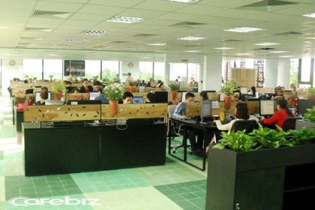

11. Security Assurance
Security Room
Client Security Tool | System Security Tool
McAfee Endpoint security (AV, Host IPS) | McAfee IDS/IPS, McAfee Web gateway (Proxy), McAfee ePO, Checkpoint Firewall
McAfee Host Firewall | ForeScout NAC
McAfee DLP Endpoint (Device Control) | CyRadar - Threat Detection, IBM QRadar SIEM
McAfee File and Removable Media Protection (encryption) | Rapid7 Nexpose, Rapid7 Nexpose, Acunetix, Nessus for Vulnerability scan, Penetration test of system
McAfee Application Control | ManageEngine AD Audit, AD Manager
ForeScout NAC client | Microsoft SCCM, Microsoft Office 365 EMS
ISO 27001:2013
(BS 7799 -2:2002)
No | Item | Description
1 | Security camera/door | Security cameras are working on at the all Entry Gates along with secure doors
2 | Hardware/devices | All assets of projects are kept inside room and managed to follow asset management process
3 | PC security | The data are not allowed to share/copy to portable devices without permission
4 | Email security | Email is monitored. The engineer cannot send data to other online storage.
International Security Standards

Slide 22
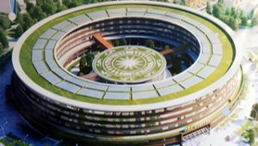
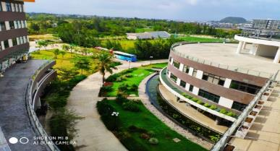
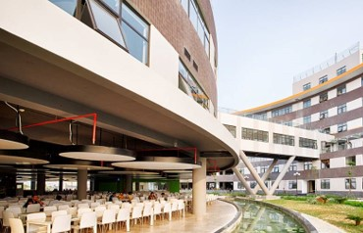
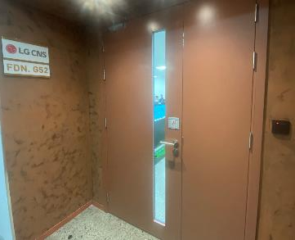
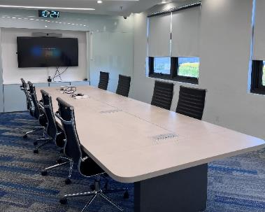
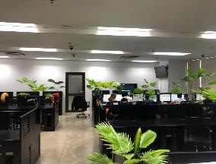
12. Working space – FPT Software Da Nang
This project will be developed at FPT Offshore Da Nang, Vietnam. The workplace is equipped with sufficient capacity and meets the security standards as described in the RFP.
FPT Complex Danang
Area
59、000 m²
Total capacity
10、000 employees
Phase 2 of 6、000 seats
completed in 2021
DA NANG
The workspaces are equipped with magnetic doors and permissions are set for individuals and groups.
The meeting rooms and workspaces are equipped with 24-hour surveillance cameras.

Slide 23
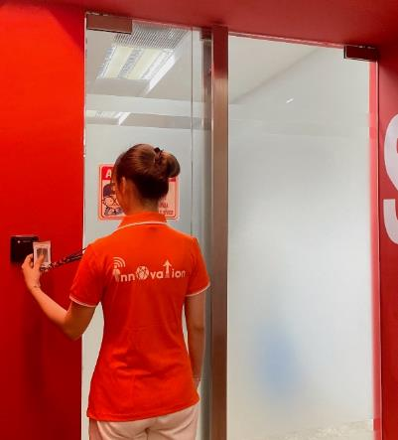
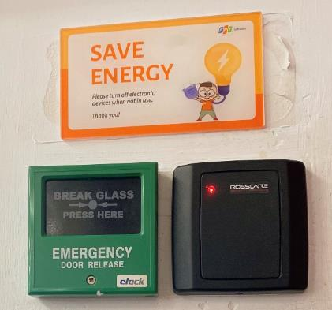
12. Working space – FPT Software Da Nang
Security Standards (BS7799, ISO27001:2013)
Security Development Room
24x7 Surveillance Cameras (Data retention period: 3 months)
  PC chain locking, HDD encryption
  Magnetic card system (Log monitoring), Access control log
  All project documents are destroyed using a shredder machine.
  All customer assets (test devices, usb tokens) are managed in a locker cabinet with personnel tracking their usage.
Security regulations
  Restriction on email recipients
  Prohibition of document removal (use of paper shredder)
  Prohibition of writing to USB memory or CD/DVD
  Prohibition of photography, audio, and video recording
Security network
  Firewall
  Antivirus
Regular checks by customers
  Monthly confirmation through security check sheets provided by customers
  Annual visit by customers for direct verification (the timing of security audits by customers can be discussed separately)
4.4. オフショア開発のセキュリティ対策
※ FPT's security regulations will be provided separately and explained during the project planning phase.

Slide 24
13. Standard Process - Overtime Process
Request OT with additional fee
Request OT by updated working time agreed by all parties (no additional fee)
LGCNS PM
GDC Governance Team
GDC leader of each divisions
FPT DM/BrSE Leader
BrSE/Offshore PM
Send overtime request
Inform to related stakeholders
Catch up OT request information
Apply for all contract type
(Turnkey, T&M, Operation contract)
Review OT reasons
Except for urgent cases, the OT request needs to be requested at least 1 day
Confirm
Feedback the reason to customer
No
CC: LGCNS GDC
Yes
Review OT effort
Estimate OT effort
Record OT Data
Confirm
Yes
Do the OT tasks
No
Verify OT Data
CC: DM/BrSE Leader
Send OT Data
Report OT Data to related stakeholders
Discuss with Offshore team
Save OT Data Report

Slide 25
13. Standard Process - Replacement Process (From FPT)
GDC Governance Team
GDC leader of each divisions
LGCNS PM
FPT DM/BrSE Leader
Offshore PM
New Member
Old Member
Catch-up member resignation information
Inform to LGCNS/GDC
Request
Resignation
Create Handover Plan + Propose New Candidate
Inform to LGCNS right at the time receive information from member
Review
Inform: GDC weekly report
Yes
Approve
No
Update
Review
Handover duration:
2 - 4 weeks
Approve
No
Yes
Do Handover tasks
Evaluate GDC stability /strength/performance
Inform
Approve
Report Handover tasks

Slide 26
13. Standard Process - Replacement Process (From FPT)
GDC Governance Team
GDC leader of each divisions
LGCNS PM
FPT DM/BrSE Leader
Offshore PM
New Member
Old Member
Catch-up member resignation information
Create Handover Plan + Propose New Candidate
Inform to LGCNS/GDC >=45 days in advance.
Changing Project
Review
Inform: GDC weekly report
Approve
No
Yes
Update
Review
Approve
No
Handover duration:
2 - 4 weeks
Yes
Do Handover tasks
Evaluate GDC stability /strength/performance
Inform
Approve
Report Handover tasks

Slide 27
13. Standard Process - Replacement Process (Request by LG CNS)
GDC Governance Team
GDC leader of each divisions
LGCNS PM
FPT DM/BrSE Leader
Offshore PM
New Member
Old Member
Request to replace members
Discuss & Find The Root Cause/Countermeasure
Need to Replace ?
Yes
Inform to GDC/FPT at least 30 days in advance.
No
Feedback to LGCNS
Create Handover Plan + Find New Candidate
Review
Inform: GDC weekly report
Approve
Update
Yes
No
Review
Handover duration:
2 - 4 weeks
Approve
Yes
No
Do Handover tasks
Capture the processing progress and perspective of LG CNS PM
Inform
Approve
Report Handover tasks

Slide 28
13. Standard Process - WFH (Work From Home) Process
LGCNS PM
GDC Governance Team
GDC leader of each divisions
FPT DM/BrSE Leader
Offshore PM
BrSE/Offshore Member
Request
Check backup proposal (method/person) in Onsite/Offshore team in case LGCNS need to contact in urgent case
In case “No”: Specify the detail of reason
Accept backup proposal ?
No
No
Yes
Inform: GDC weekly report
Confirm
Send WFH request + Backup proposal
Yes
Log ticket to get Thin Client + use FSOFT VDI from home
Attach approval evidence with Ticket
Approve
*Important: Member have to use Thin Client (Laptop) configured by FPT IT to connect to LGCNS
Get confirmation from LGCNS is enough
(GDC is used in the backup case only)
Work from home
Record WFH Data
Must connect to Fsoft VDI before connecting to LGCNS VDI

Slide 29
13. Standard Process - Issue/Failure Reporting Process
Division | Disability Awareness/Reception | Report/Action on failure | Failure end report/post management
Workplace
Reporting system diagram
Code of Conduct
Disability Report
Failover
Recovery complete
Fault end report
failure
Send SMS in case of failure
When action is delayed Share action status
Send SMS when recovery is completed
Disability report
Send SMS by grade
Immediately upon occurrence
Within 30 minutes of occurrence
Notice of scheduled action time
Action status
Estimated Completion Time
Work in Process
Guide to normalization immediately
Grade 1, 2, 3
Written report within 24 hours after recovery
Face-to-face report within 7 days of recovery
(Reported at Weekly meeting)
Situation Reception and Sharing
Target for sending SMS by grade
Grade 1 | Development Innovation Center Leader, FPT CEO, Development Innovation Team Leader, GDC Group, Delivery Manager Sales Manager, Project PM
2nd grade | Development Innovation Team leader, GDC Group, Delivery Manager, Sales Manager, Project PM
3rd grade | GDC Group, Delivery Manager, Sales Manager, Project PM
Ranking judgment
※ GDC HQ and development and innovation Team leader notified of the results(including failure reports)
※ Disability registration management
Delivery Manager determines the rating
GDC failure grade (grades 1, 2, 3)
Br.SE/
Offshore PM
GDC HQ
Development Innovation Team Leader
Development Innovation Center Leader
FPT CEO
(Level 1)
Delivery Manager
(2nd, 3rd grade)
For all failures, Br.SE/Offshore reports the situation to Delivery Manager
Delivery Manager reports status based on company-wide failure rating criteria
  After notification of failure by first SMS, select one of SMS/Mail/Phone and report on the status of failure action and recovery completion
  Re-announcement of the status of interim measures regarding the status of measures for obstacles
  Sending SMS to normalize recovery completion
To prevent recurrence of similar disorders
Failure reporting management
*All disability reports
Be sure to contact GDC HQ
Must be provided

Slide 30
13. Standard Process - Issue/Failure Grading Criteria (2/3)
If there are no criteria for grading customer issues, we can determine the severity of the issue based on our own severity criteria and considering the impact on the customer.
Grade | The meaning of each severity level | Category |  |  | Resolution SLA
 |  | Application | Network | Server
1st Grade (Level1) | Critical service issues are those that result in commercial losses, operational disruptions, and negative impacts on both customers and our company's reputation. - In instances where there is a high likelihood of media exposure or significant media exposure - In situations where there is a potential for legal violations Service disruptions resulting in operational losses for both our company and the customer. Cases where service interruptions and system failures impact other systems. | Disruption of entire transactions across two or more modules. Disruption of interfaces No availability issues, but abnormal behavior. | Domestic/International WAN Backbone Network Center B/B LAN | Operational systems directly related to the unique business of the business unit. Operational systems directly related to overseas project systems. Interface systems Enterprise-wide common support systems | Within 2 hours
2nd Grade (Level2) | Non-Critical Service Issue If service is available through alternative systems. - Manual work is not considered an alternative system (Level 1 incident). | Disruption of entire transactions across one or more modules Interface delay Delay in scheduled/agreed-upon tasks | Domestic/International Tail WAN issue Domestic/International Site LAN issue Firewall H/W issue DNS/Mail Relay issue | Business support systems Non-business systems | Within 4 hours
3rd Grade (Level3) | Interruption of individual program transactions Minor disruptions affecting business operations Service not completely disrupted but experiencing some functional errors | Interruption of individual program transactions Regular tasks not executed | Unit Workgroup Network Issue | Specific departmental business system Promotional system for a unit department | Within 8 hours

Slide 31
13. Standard Process - Issue/Failure Grading Criteria (3/3)
Determining the severity of issue from Biz Impact perspective by integrating the impact Factor with System Importance Ratings.
For organizations that have not defined ratings for each system, severity is assessed based on the seriousness of the incident using a checkpoint questionnaire, and assigned a corresponding score (0-5).
Issue Severity Rating Table
구분 | 장애 영향 Factor |  | 시스템 등급(Biz Impact) |  |  |  | 장애 Check Point
 |  |  | 1 | 2 | 3 | 4
Impact 정도 | 1. 영업적/재정적 손실 |  | 5 | 3 | 2 | - | 시스템 중단으로 고객의 Business의 영업 손실이 예상되는가? 해당 장애로 고객의 재무적 손실이 예상되는가? 해당 장애로 무작업이 발생하였는가?
 | 2. 브랜드 이미지 훼손 |  | 5 | 3 | 2 | - | 해당 장애가 언론에 노출되었거나 노출 가능성이 큰 가? 해당 장애로 법률적 소송이 예상되는가?
 | 3.고객 업무 | 핵심기능 업무중단 | 3 | 2 | 1 | - | 해당 장애로 수작업으로 업무를(핵심기능) 수행하는가? 해당 장애로 타 시스템에 영향을 주는가? (I/F 불가, Batch작업 중단 등)
 |  | 업무 효율 저하 | 2 | 1 | - | - | 해당 장애로 인한 업무를 대체 시스템으로 서비스 가능한가? (수작업은 대체 시스템으로 간주하지 않음) 업무 중단은 없지만, 업무 처리가 지연되었는가?
Impact 범위 | 4.사용자 | 외부고객 | 5 | 3 | 2 | - | 對 고객 서비스 시스템인가?(B2C)
 |  | 내부 사용자 전체 | 5 | 3 | 1 | 1 | 고객의 Main시스템으로 고객사 대부분의 사용자가(임직원 50%)영향을 받는가?
 |  | 내부 사용자 일부 | 2 | 1 | - | - | 50%이하 사용자가 영향을 받는가?
 | 5.시스템 | Critical 타 시스템 | 5 | 5 | 5 | 2 | 해당 장애로 다른 Critical 시스템에(1등급시스템) 영향을 주는가?
 |  | 시스템 내부 전체 | 3 | 2 | 1 | - | 해당 장애로 단일 시스템 전체에(또는 생산라인 30%이상) 영향을 주는가?
 |  | 시스템 단위 모듈 | 2 | 1 | - | - | 해당 장애로 단일 시스템의 일부 모듈/프로그램에(생산라인 30%미만) 영향을 주는가?
 | 6. 고객 인지 범위 | C-Level | 3 | 3 | 3 | - | 고객의 C-Level까지 보고/인지되었는가?
 |  | 주요실무조직 | 2 | 1 | 1 | - | 해당 시스템 主 시용 조직 또는 CIO 조직(정보전략)
 |  | 일반 사용자 | 1 | 1 | - | -
Grade determination based on the total sum of Impact scores
Impact 점수 | 15점 이상 | 10점 ~ 14점 | 5점 ~ 9점 | 4점 이하
장애 등급 | 1등급 | 2등급 | 3등급 | 4등급(이벤트)
※ 장애 복구 목표시간 초과 시 1등급 상향 조정
- 1등급 : 2시간 / 2등급 : 4시간 / 3등급 : 8시간

Slide 32
13. Standard Process - Drop/Postpone/Delay Project Process
LG CNS
GDC Governance Team
GDC leader of each divisions
FPT DM/BrSE Leader
Offshore PM
# | Category | Explanation
1 | Scope | LGCNS requested to postpone the project after starting project LGCNS requested to stop the project after confirming quotation LGCNS requested to delay the start date of project after confirming quotation
2 | Formula For Postpone Quotation | Drop/Postpone/Delay Quotation (MM) = actual spent working days / 20
Request drop/ postpone/delay project
Request date after project start date
Inform offshore team
No
Yes
Create drop/postpone/delay quotation
Review
Inform: GDC weekly report
Approve
No
Yes
Update
Approve
No
Yes
Release members
Efficiently manage released resource pool.
Suggest allocating released members in other project.
Record released members
Report to GDC to arrange other works for released members
Report to FPT DM/BrSE Leader

Slide 33
13. Standard Process - Security Compliance Process
LGCNS PM
GDC Governance Team
GDC leader of each divisions
FPT Korea DM
Offshore PM
Worksteam leader
IT ISM
Members
Report to LG CNS Security team
Inform result
Analyze Security Vulnerability
Inform
Notice suspicious email (phishing email).
Review report
Review/Collect report from PM
Evaluate situation and
Collect information from team
Inform
Warning announcement for all PMO
Inform within 24h in advance.
Preventive Scenario
Don’t forward email
from LG CNS domain
to FPT domain
Collect information from team
No
Analyze Incidents
Inform
Interacted/clicked on a suspicious email
Review report
Review/Collect report from PM
Yes
Report to LG CNS Security team
Conduct preventive actions/remedial actions
Inform within 2h in advance.
Consult on actions and inform LG CNS IT
Conduct preventive actions with member
Inform
Don’t provide more information and interact with email/website
Disconnect device/cloud from the network
Scan system/cloud for Malware
Backup files
Warning announcement for all PMO
Incident Scenario

Slide 34
THANK YOU!
↘
Contact Person: Mr/Ms. ABC
Project Manager
Email: abc@fpt.com

